Slide 1
Web Components

Slide 2
Agenda
Standard & Specs
Web Component Tools
vs. Frameworks
Demo

Slide 3
Standard & Specs
Main technologies:
HTML Templates
Custom elements
Shadow DOM
Custom Events
Defined by W3C
Supported by all* browsers

Slide 4
Lifecycle Hooks
constructor()
Shadow Dom / event listeners / state
connectedCallback()
Added to DOM - set attires / fetch resources
disconnectedCallback()
Removed from DOM - unsubscribe/ unregister
attributeChangedCallback()
static get observedAttributes()

Slide 5
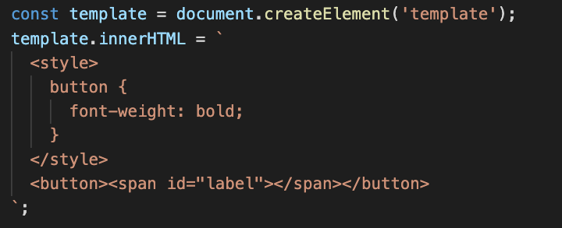
HTML Template

Slide 6
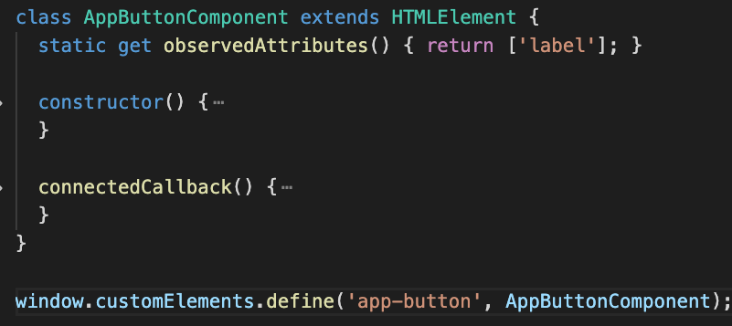
Custom Elements

Slide 7
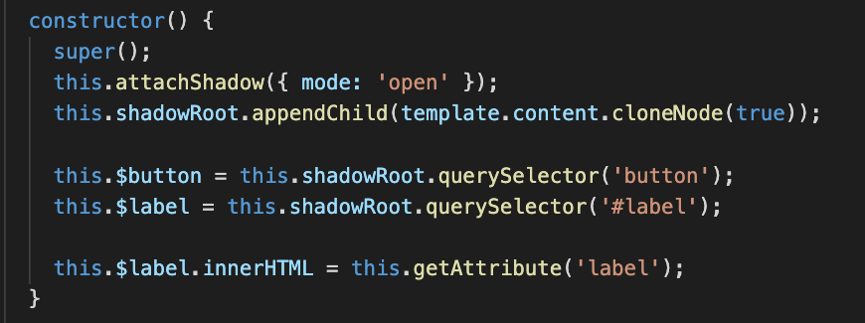
Shadow DOM

Slide 8
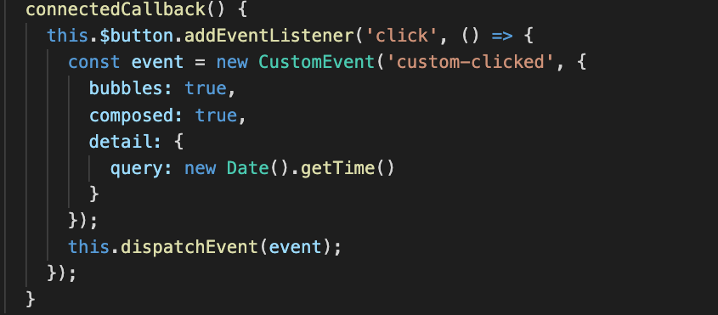
Custom Events

Slide 9
Web Component Tools
Polymer
Google backed / LitElement / lit-html
Stencil JS
Ionic backed / Virtual DOM + Typescript + JSX /compiler that generates WCs
Vue CLI
vue-cli-service
build--target wc --name my-element [entry]

Slide 10
Polymer
Decorators (Stage 2)
@customElement, @property / Typescript or Babel
Lifecycle hooks
Inherited from HtmlElement
render()
using lit-html
static styles()

Slide 11
Polymer

Slide 12
Stencil
Decorators
@Component, @Prop, @State, @Watch, @Element, @Event, @Listen
Lifecycle hooks
connectedCallback(), componentDidLoad(), componentWillUpdate()
render()
jsx / tsx

Slide 13
Stencil

Slide 14
vs. Frameworks
Web Components
W3C standard / browser support / simple APIs
Frameworks
SPA Routing
State Management
Modularity / Composition
Scaffolding
CLI
Deployment

Slide 15
vs. Frameworks

Slide 16
Demo
https://github.com/ionutvelicu/webcomps

